Slide 1
Til All of Us Are Free:
A Liberatory Framework for DEI in Chamber Music Organizations
ChamberQUEER
January 6, 2023 | CMA Conference
Notes:
Brian: quick welcome, thanks for coming, intro: 1 min

Slide 2
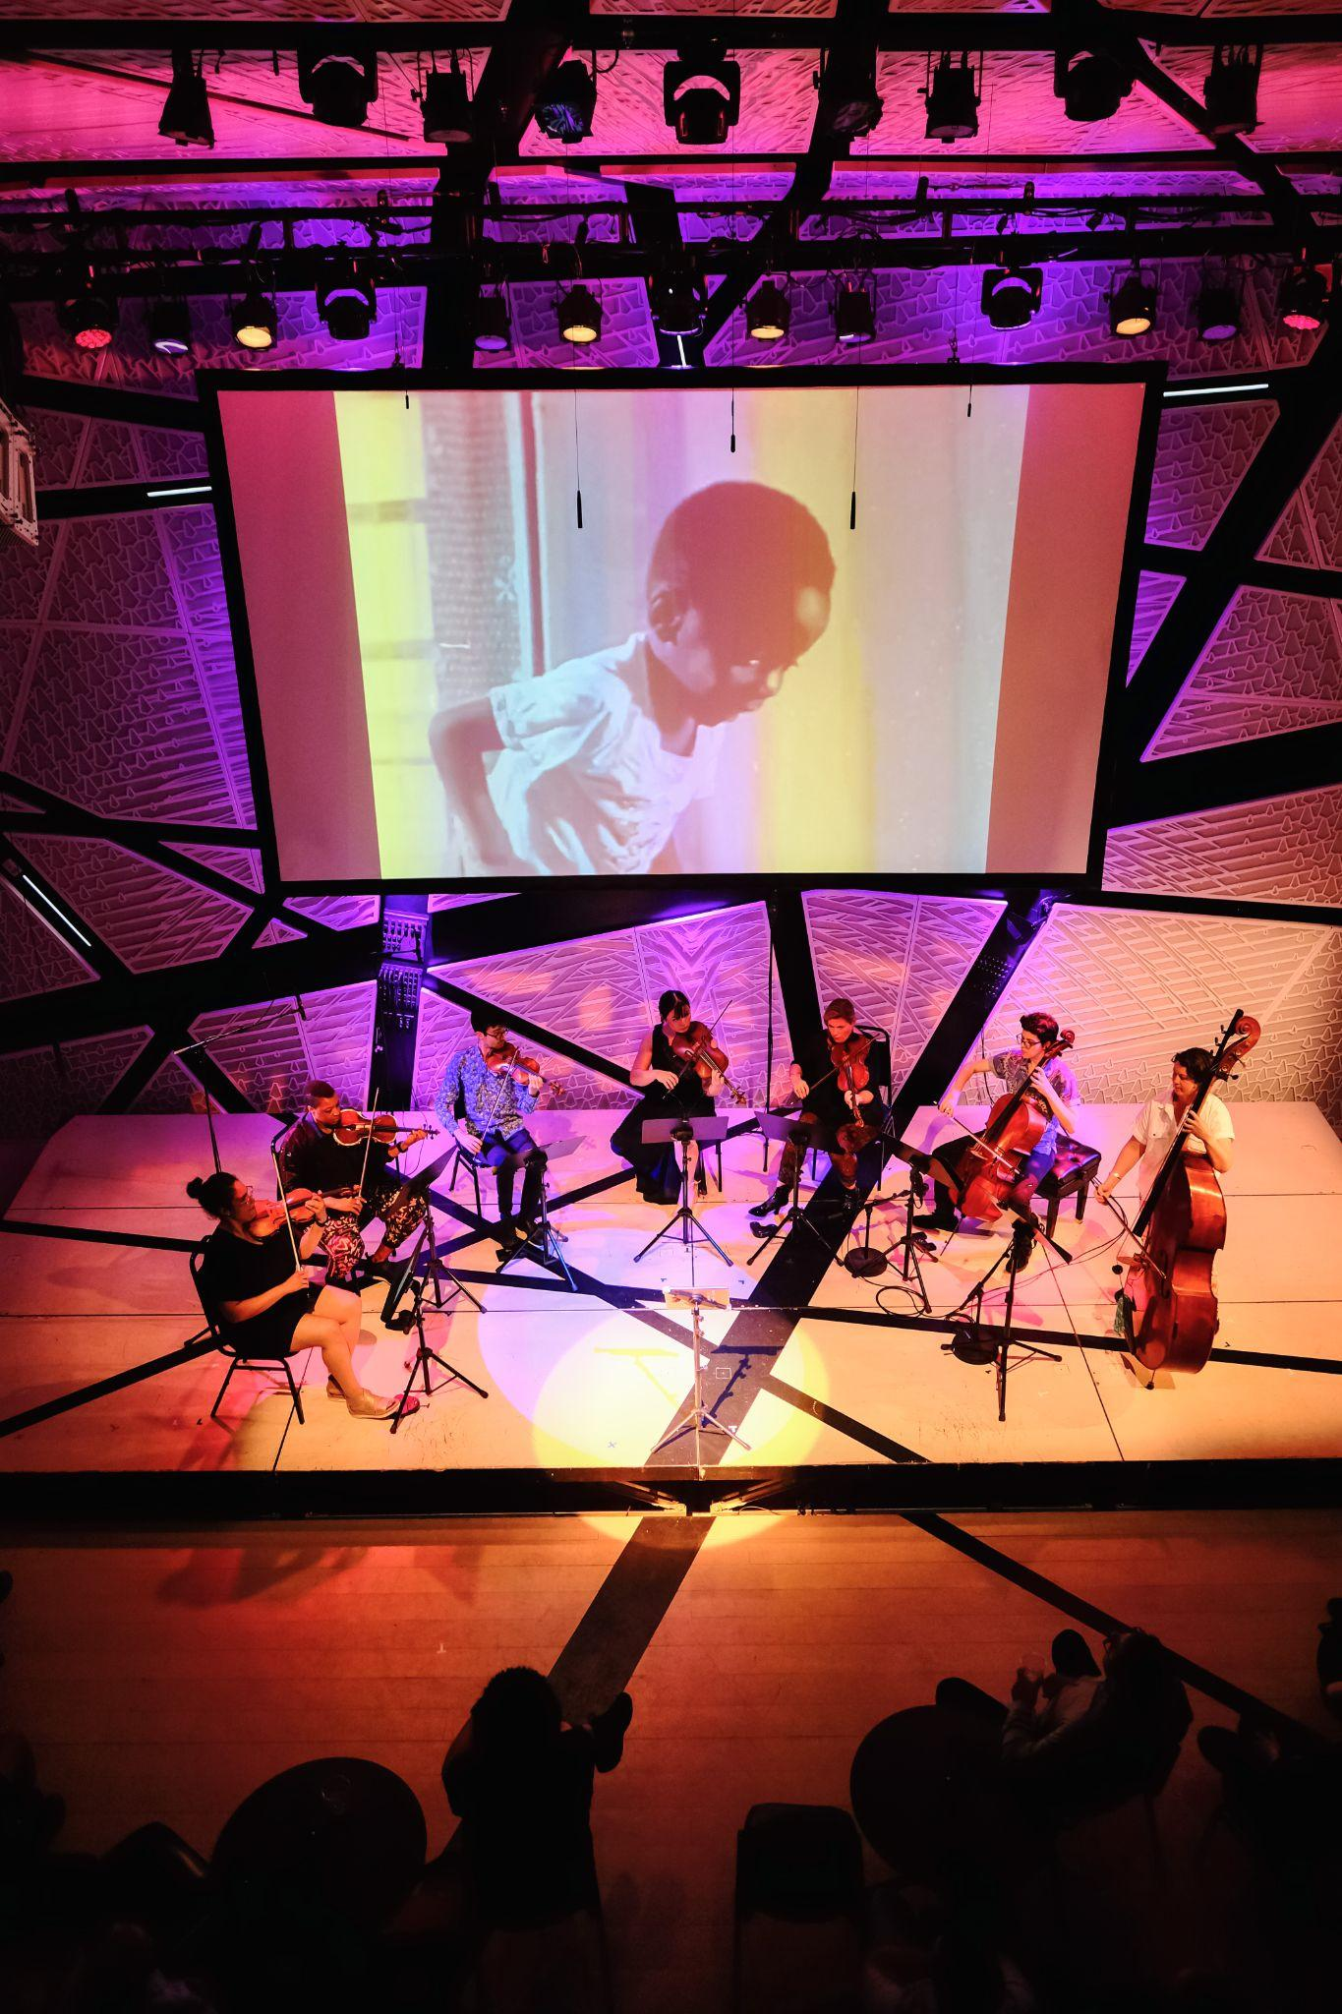
ChamberQUEER highlights contemporary and historical LGBTQ+ voices in classical music and reimagines the concert experience to create radically inclusive musical spaces and communities for the 21st century.
Concert programming is fully collaborative: with performers and creators/composers, interdisciplinary, experimental
Audience development: build relationships with queer orgs and affinity orgs in greater NYC area
Spacemaking: free community events, affordability, access
Educational/advocacy: webinars, consulting, educational sessions
Sean Salamon
Notes:
Danielle: we are ChamberQUEER, mission, brief explanation of each bullet point and how it relates to mission, max 2 min. Annual June festival has gradually evolved from a more traditional, plug artists into program, or present artists with their own programs, to devising work in collaboration with a community built over long-term. This goes for audience devt too. We will get into how this relates to queer liberation framework later.

Slide 3
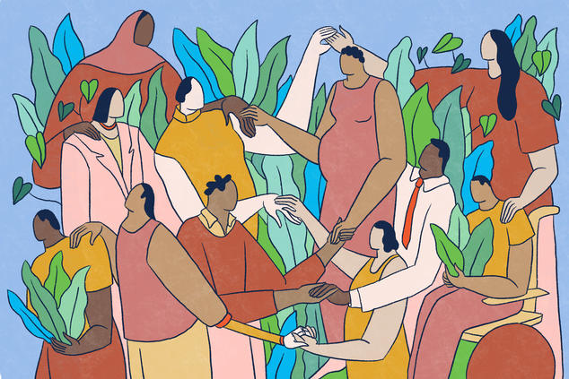
In today’s session…
Introductions
Group Agreement
Definitions and Context-Building
Interactive Activity: Case Study
Debrief & Discussion
Question & Answer Period
Alexandra Bowman
Notes:
Danielle max 1 min. Say how we want them to be aware of how we are structuring, wording, framing things – take note of what resonates with you, what raises questions etc

Slide 4
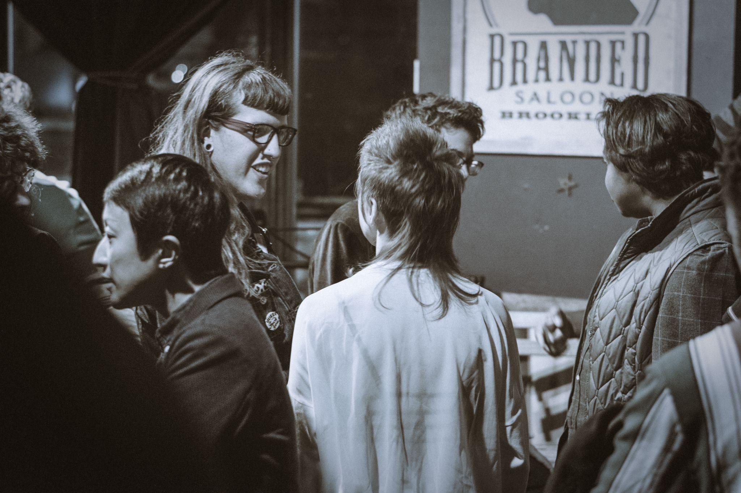
Introductions
Name
Pronouns (she, they, he, etc)
Your role in the music world
How you’re feeling today
Liz van Os
Notes:
Mazz? This activity should be allotted maybe 8 minutes total. Each panelist will do a brief intro, then Jules, then invite groups to do it amongst themselves. Mention pronouns are optional/can change, etc – requiring sharing can be harmful, too

Slide 5
Group Agreement
NOTE: Every group agreement is a living document! Great to revisit over the course of collaboration
Respect people’s names and pronouns, and apologize if mistakes are made
Use “I feel…” statements - “I” language
Invitation-focused language—the space is an invitation to share! Encourage compassion and bravery/vulnerability
Listen to the end of someone’s thought—hold space for each other’s ideas, and for silence to think/feel after someone expresses something
Intent vs. Impact: we assume that people have good intentions, but they may unintentionally cause harm:
Allow people space to articulate having been hurt by something done or said
Take accountability when you feel you might have said/done something painful
Share the mic: How much are you speaking in relation to others? Speak up, but share the space; invite people who are more quiet to have space to speak
Notes:
5 min? Who would like to introduce this, why it is important, and how we did it. It doesn’t need to be read out loud in full, but some important points should be spoken and explained.

Slide 6
Definitions and Context-Building
Notes:
Aiden: brief explanation about why we are going through some terms, and anything you want to say about your definitions. Max 1 min

Slide 7
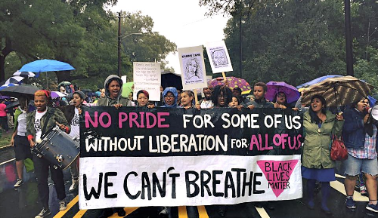
Queer Liberation
The act of setting all LGBTQ+ people free from oppression
Micah Bazant
Notes:
DANIELLE
Started in 60s, owes roots in big ways to civil rights mvt, that is, to BLK FEM and antiracist ideology and practices. Thus “Nobody’s free until all of us are free” (Hamer), “no pride for some w/o liberation for all (Rivera). Antiracism powers queer lib. Collective uplift, solidarity, mutual aid at the heart queer liberation. This is in response to oppression and necessity. People who need each other, and who are forgotten or excluded by society, band together to work on mutual uplift. So if you're an org who is transforming to be inclusive you may have some gaps to bridge not just in personnel and programming, but structurally and culturally, in major assumptions about priorities, values that guide decisions- what those decisions are, how they are made and with whom and by whom, what working relationship looks like… etc. we work for queer liberation and we think this concept has a lot to offer as orgs decide what changes to make and how.

Slide 8
Diversity
a workplace, community, etc that contains people from varied backgrounds and with varied identities
Notes:
Mazz

Slide 9
Equity
changing organizational structures in order to lift up those who have been historically and/or who are currently oppressed by the dominant societal identity.
“Leveling the playing field” through proactive and integral changes to an existing institution or organization
Notes:
Brian

Slide 10
Inclusion
creating a workplace, community, organization, etc that respects and values all viewpoints, and therefore allows all identities to come into the space with their full selves
Notes:
Aiden

Slide 11
Justice
The act of moving toward equity in all aspects of society through reparations and proactive change to existing societal structures
Notes:
Mazz

Slide 12
Access
Creating a physical or virtual space that is easy to use and interact within for all abled and disabled people
Notes:
Aiden

Slide 13
Disability
the inability for a person to fully participate with others due to a societal barrier or structural inefficiency
Disability Justice
the act of moving toward equity for all disabled people
Notes:
Aiden

Slide 14
Pause for Questions
Notes:
Brian invite questions

Slide 15
Activity: Case Study
Notes:
Danielle

Slide 16
Case Study
A touring, small/chamber ensemble is planning their 2024-25 season and seek to diversify their audience and donor base in both age and race/ethnicity.
As a group, agree to choose the perspective of one of the parties below. Then, have a conversation about what strategies might be applied to this challenge.
Perspective options:
Ensemble Member
Booking Management
Ensemble Board Member
Local Presenter
Senior Admin (e.g. Executive Director)
Some (leading) questions:
How can the organization learn about and build rapport with the communities in question, so their interactions can be effective?
What kinds of structural changes within the organization could facilitate these goals? Who might need to be included in those decisions?
How can the organization’s administrative decision-making processes reflect the kinds of artistic relationships that the organization hopes to build?
What successful strategies have you or others undertaken that you can share with your group?

Slide 17
Debrief and Discussion

Slide 18
Q&A

Slide 19
Thank you
www.chamberqueer.org
hello@chamberqueer.org
Facebook/Instagram: @chamberqueer
Please keep in touch
Visit chamberqueer.org/cma for session materials and a reading list
Notes:
Visit chamberqueer.org/CMA for a reading list and the slides

